Slide 1
Vehicle Automation
Coordinate Systems

Slide 2
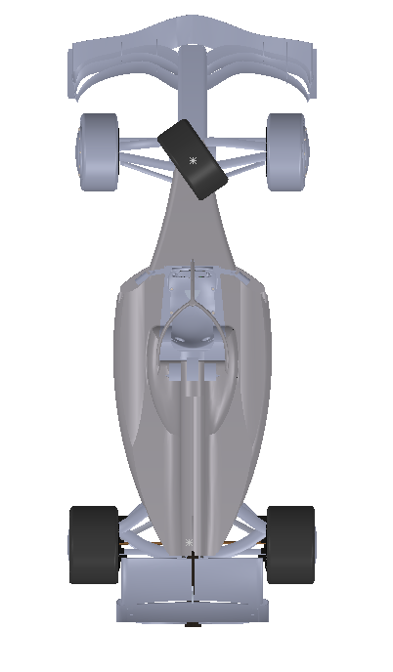
Attach a coordinate system to the vehicle. We chose x_{veh} as ‘forward’ and z_{veh} as ‘up’.
We will keep track of the vehicle pose (position & orientation) in terms of the world system by the coordinates of point P_{vo} and the angle θ.
We will use units of meters for the x,y coordinates of ^{world}P_{vo}.
The angle θ will be measured from the direction of x_{world} to x_{veh} in a right-hand sense about z_{world}.
y_{world}
x_{veh}
θ
Vehicle Coordinate System
World Coordinate System
y_{veh}
x_{world}
P_{vo}

Slide 3
Some observations:
y_{world}
x_{veh}
θ
Vehicle Coordinate System
World Coordinate System
y_{veh}
x_{world}
P_{vo}
direction vectors have no dimensions

Slide 4
Coordinate Transformation Problem
given:
find:
P₁
1.2 m
2.5 m
y_{world}
x_{veh}
θ
Vehicle Coordinate System
y_{veh}
P_{vo}
Vwo→Po
x_{world}
World Coordinate System

Slide 5
Coordinate Transformation Problem
given:
find:
P₁
1.2 m
2.5 m
y_{world}
x_{veh}
θ
Vehicle Coordinate System
y_{veh}
P_{vo}
Vwo→Po
x_{world}
World Coordinate System

Slide 6
Would like to have the world coordinate system lined up where the unit vector x_{world} pointed East and the unit vector y_{world} pointed North.
but where is the origin of the world coordinate system?
and the world is round, so pointing East here in Gainesville is not really the same direction I would point towards the East if I was in Seoul.
y_{world}
x_{veh}
Vehicle Coordinate System
World Coordinate System
y_{veh}
x_{world}

Slide 7
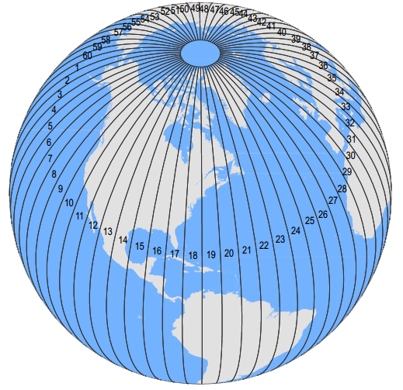
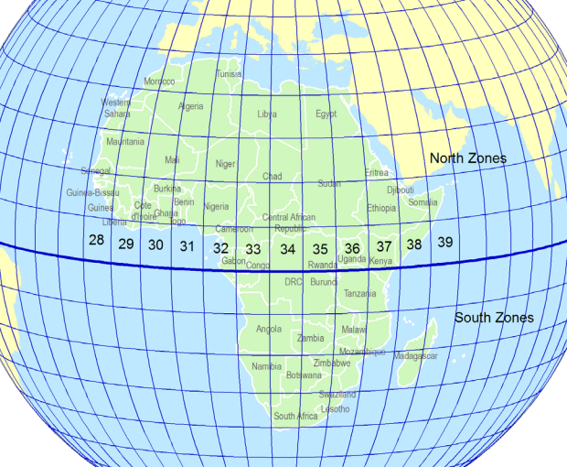
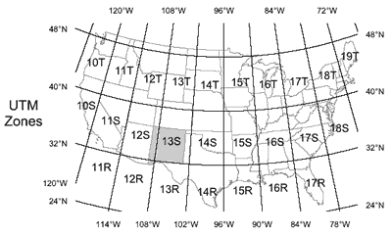
Universal Transverse Mercator (UTM) Coordinates

Slide 9
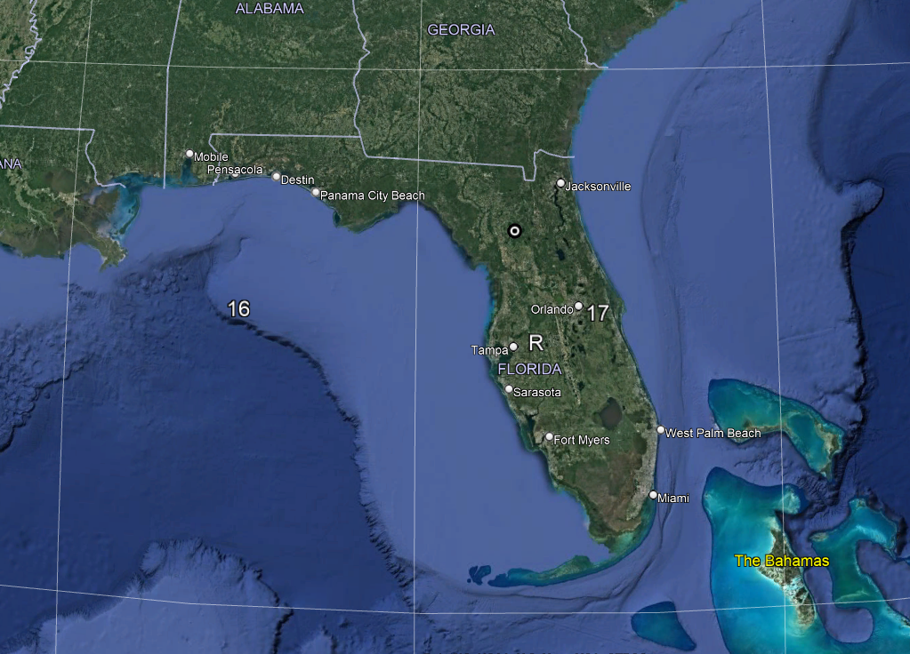

Slide 10
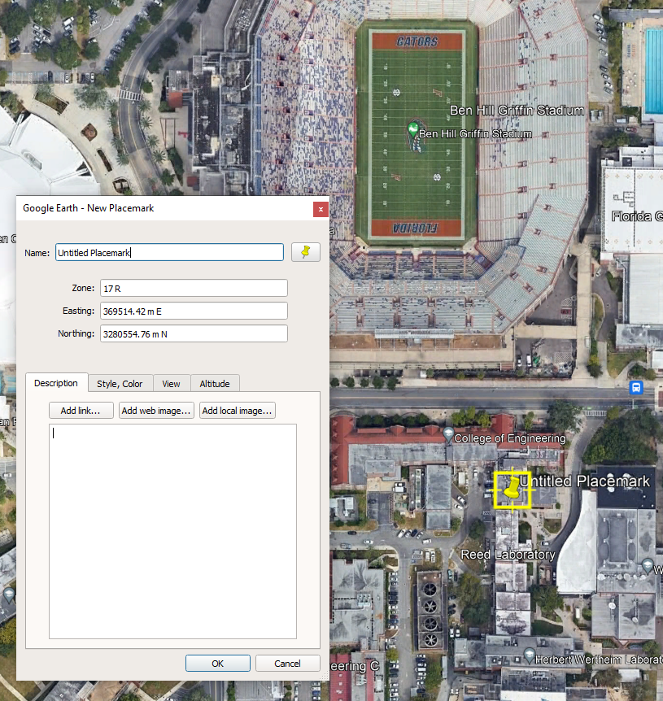
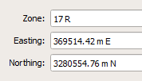
Looks like Google Earth is offering cm level accuracy.

Slide 11
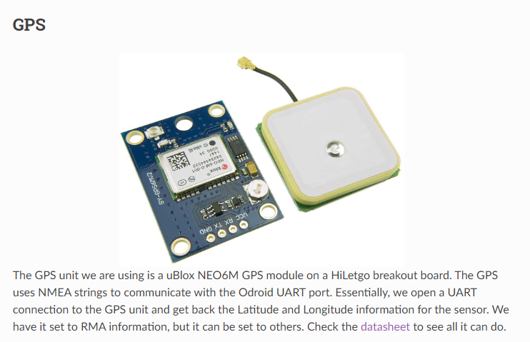
But what kind of data does a GPS report?

Slide 12
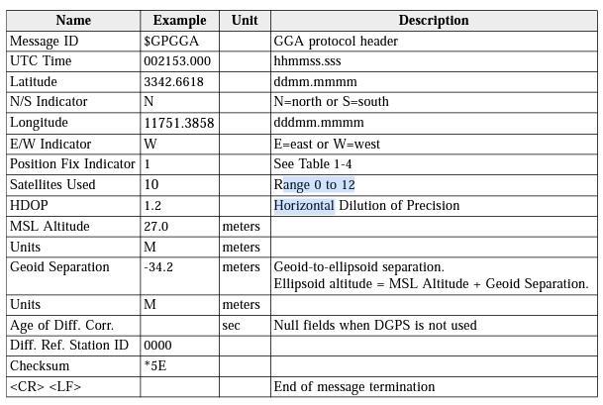
Let’s look at a typical standard GPS message:

Slide 13
Conversion from latitude/longitude to UTM coordinates is a standard task.
# Call this program as follows:
# py convert_to_UTM.py input_file.txt output_file.txt
#
# This program opens the file 'input_file.txt' which has latitude and longitude data on each line
# where the values are separated by a comma. Each latitude/longitude pair is converted to UTM coordinates.
# The file 'output_file.txt' will have the Easting, Northing, Zone Number, and Zone Letter values on each line.
import utm
import sys
import math
import numpy as np
import csv
def main():
num_arg = len(sys.argv)
if (num_arg < 3):
print('Not enough arguments provided:')
print('\tUseage: convert_to_UTM.py input_file.txt output_file.txt')
exit()
else:
fp = 0
fp_out = 0
in_filename = sys.argv[1]
out_filename = sys.argv[2]
try:
fp = open(in_filename, 'r')
csvreader = csv.reader(fp)
rows = []
for row in csvreader:
rows.append(row)
except IOError:
print ('Error: The file ' + in_filename + ' does not exist.')
finally:
if (fp != 0):
fp.close()
try:
fp_out = open(out_filename, 'w')
for row in rows:
my_lat = float(row[0])
my_long = float(row[1])
utmData = utm.from_latlon(my_lat, my_long)
my_East = utmData[0]
my_North = utmData[1]
my_Zone_Num = utmData[2]
my_Zone_Letter = utmData[3]
print(my_East, ', ', my_North, ', ', my_Zone_Num, ', ', my_Zone_Letter,file = fp_out)
except IOError:
print('Error: The output file ' + out_filename + ' could not be created.')
finally:
if (fp_out !=0):
fp_out.close()
if __name__ == '__main__':
main()

Slide 14
Vehicle Automation
Vehicle Controller Node

Slide 15
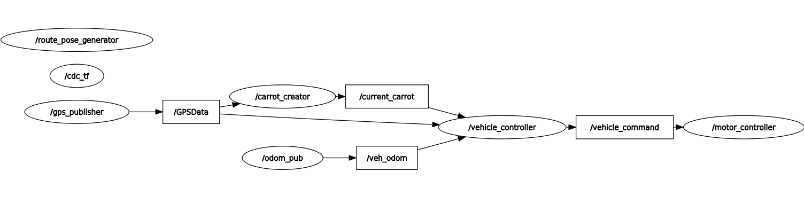
Inputs:
goal pose (^{W}x_{goal} , ^{W}y_{goal} ,θ_{goal})
closest pose (^{W}x_{close} , ^{W}y_{close} ,θ_{close})
current pose (^{W}x_{current} , ^{W}y_{current} , θ_{current})
speed, v_{x}
Outputs:
Ackermann(v_{x},0,0 ; 0,0, ω_{z})
Units and coordinate systems are very important.
x_{world} axis will be along true East
y_{world} axis will be along true North
x_{goal},y_{goal} and x_{current}, y_{current} will be in meters
θ, will be conveyed using quaternions (radians), measured from the x_{world} axis in a right-hand sense about z_{world} (up)
speed v_{x} will be in m/sec, measured in the vehicle coord system.

Slide 16
Inputs:
goal pose (^{W}x_{goal} , ^{W}y_{goal} ,θ_{goal})
closest pose (^{W}x_{close} , ^{W}y_{close} ,θ_{close})
current pose (^{W}x_{current} , ^{W}y_{current} , θ_{current})
speed, v_{x}
Outputs:
AckermannDriveStamped message(drive.steering_angle, drive.speed) units are radians & m/sec

Slide 17
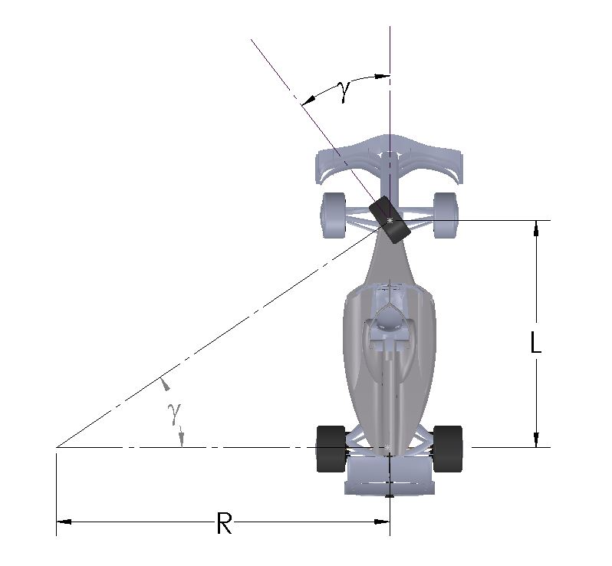
There is a relationship between the steering angle and the radius of curvature
R = radius of curvature
L = wheelbase dist
γ = steering angle
(1)
A left-hand turn will be a positive γ angle.
A right-hand turn will be a negative γ angle.
x_{veh}
y_{veh}

Slide 18
Vehicle Controller Approaches
point-at-carrot
circular arc
3rd order curve
Stanley
modified Stanley
Inputs:
goal pose (^{W}x_{goal} , ^{W}y_{goal} , θ_{goal})
closest pose (^{W}x_{close} , ^{W}y_{close} ,θ_{close})
current pose (^{W}x_{current} , ^{W}y_{current} , θ _{current})
speed, v_{x}
Outputs:
AckermannPoseStamped message(drive.steering_angle, drive.speed)

Slide 19
point-at-carrot controller
given:
vehicle pose, x_{veh}, y_{veh}, θ_{veh}
goal position, x_{g}, y_{g}
determine change in steering angle
e_{t} = θ_{desired} – θ_{veh}
new_steering = current_steering + K_{p} (e_{t} – e_{t-1}) + K_{i} e_{t} + K_{d} (e_{t} – 2 e_{t-1} + e_{t-2})
Note that e_{t} may be negative
(x_{g}, y_{g})
look-ahead dist
θ_{desired}
closest point
θ_{veh}
(x_{veh}, y_{veh})
vehicle pose

Slide 20
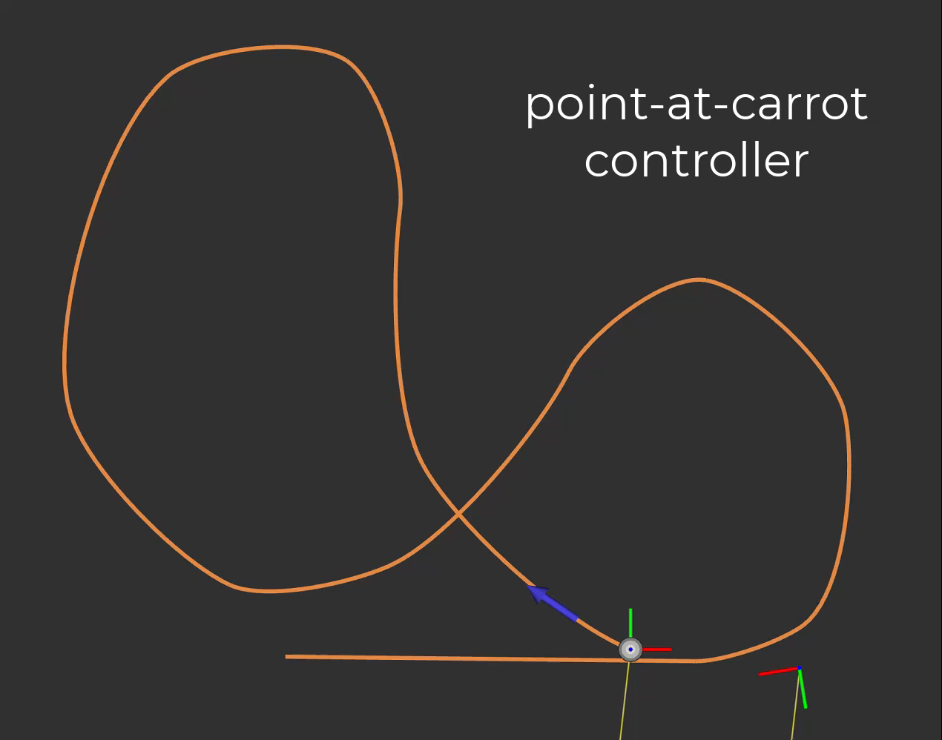
‘magic’ numbers:
look-ahead-dist = 3 m
speed = 2 m/sec
K_{p} = 3.0
K_{d} = 0.0
K_{i} = 0.1
blue arrow is goal pose
moving coord. is vehicle pose
white dot is closest point on the path to the vehicle

Slide 21
circular arc controller
given:
vehicle pose, x_{veh}, y_{veh}, θ_{veh}
goal position, x_{g}, y_{g}
determine radius of curvature
based on the circle defined by the goal point and the vehicle point and which is tangent to the current heading
(x_{g}, y_{g})
look-ahead dist
+
closest point
θ_{veh}
(x_{veh}, y_{veh})
vehicle pose

Slide 22
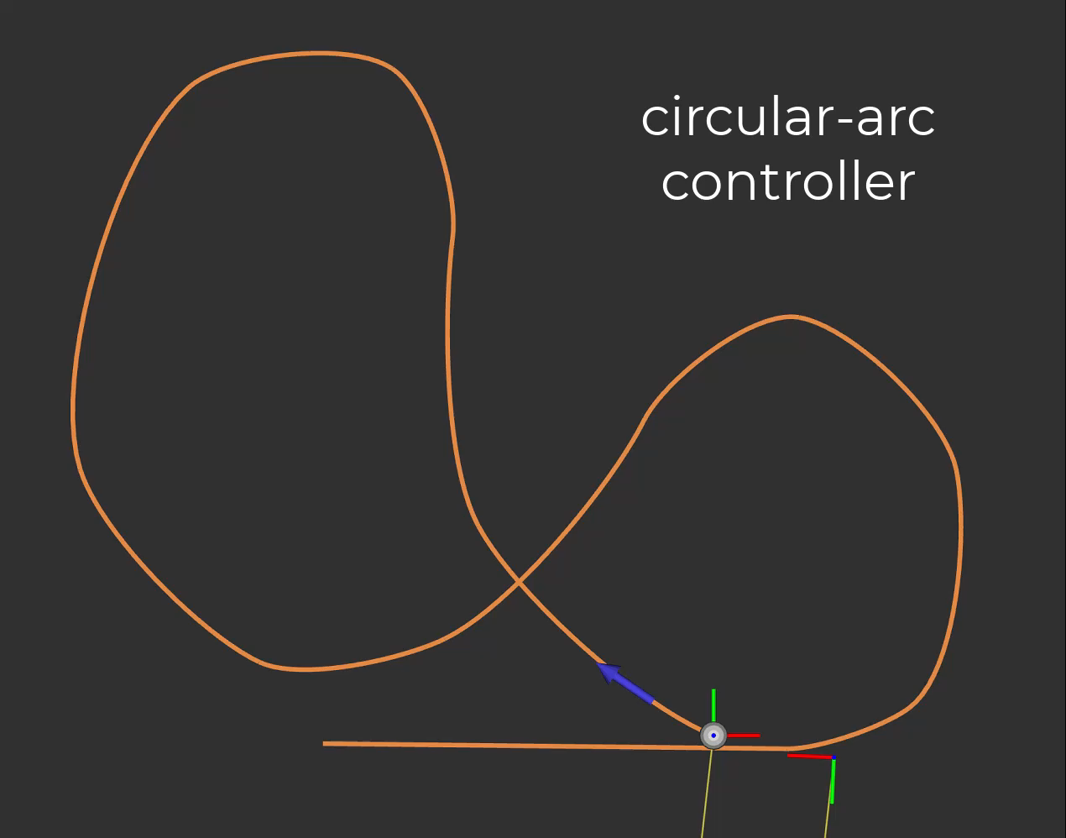
‘magic’ numbers:
look-ahead-dist = 3 m
speed = 2 m/sec
blue arrow is goal pose
moving coord. is vehicle pose
white dot is closest point on the path to the vehicle

Slide 23
3rd order controller
given:
vehicle pose, x_{veh}, y_{veh}, θ_{veh}
goal position, x_{g}, y_{g} , θ_{g}
generate a 3rd order curve from the vehicle pose to the goal pose
need to select cords. for control points P₁ and P₂
determine radius of curvature at start of path
(x_{g}, y_{g})
θ_{g}
L₂
look-ahead dist
+
closest point
L₁
θ_{veh}
(x_{veh}, y_{veh})
vehicle pose

Slide 24
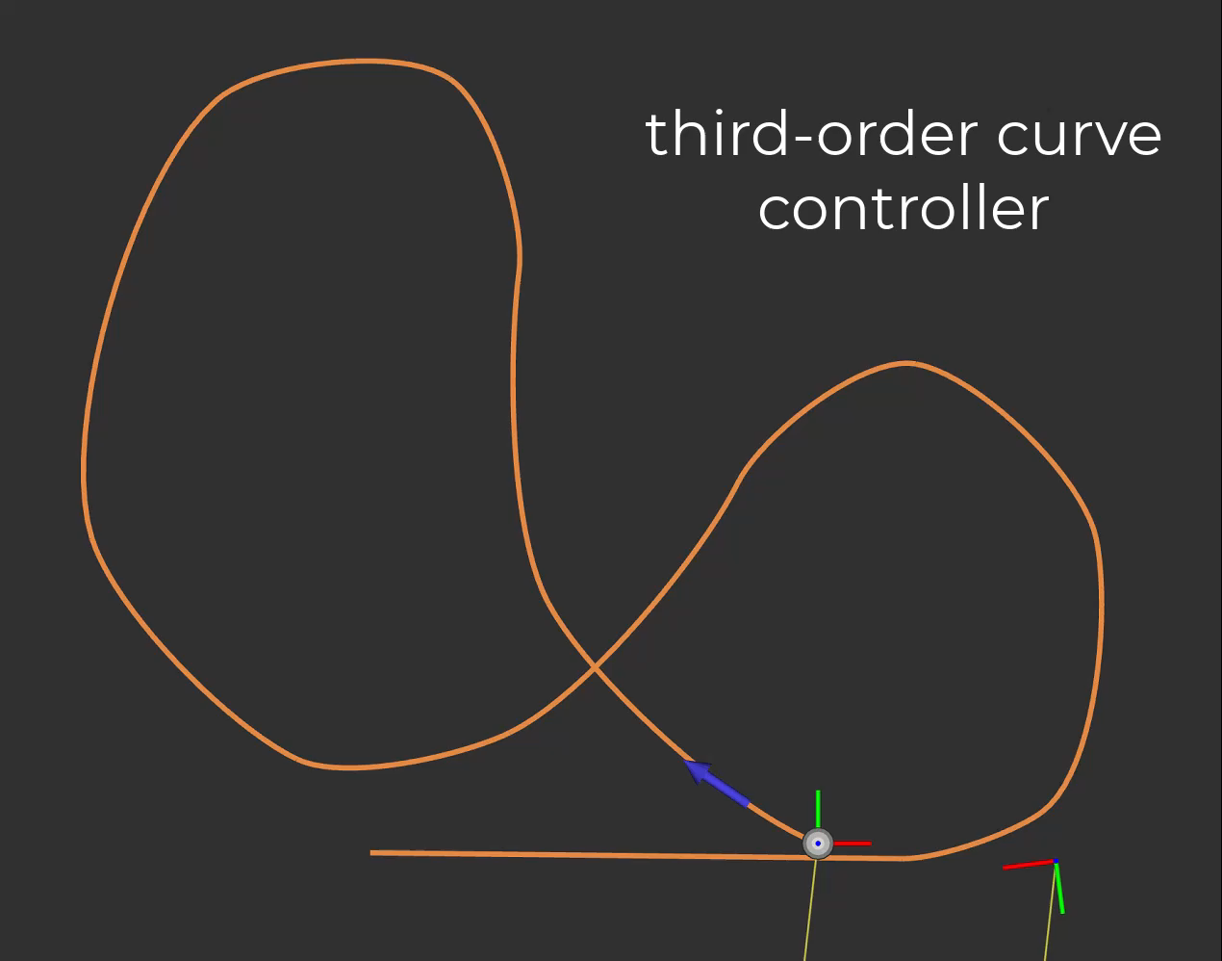
‘magic’ numbers:
look-ahead-dist = 3 m
speed = 2 m/sec
L₁ = d/4
L₂ = d/4
w₁ = 1
w₂ - 1
blue arrow is goal pose
moving coord. is vehicle pose
white dot is closest point on the path to the vehicle

Slide 25
stanley controller
given:
vehicle pose, x_{veh}, y_{veh}, θ_{veh}
closest pose, x_{c}, y_{c}, θ_{c}
determine a change in steering angle
to minimize the difference in heading θ_{C} – θ_{veh}
to minimize the cross track distance e
closest pose
θ_{C}
(x_{C}, y_{C})
e
θ_{veh}
(x_{veh}, y_{veh})
vehicle pose

Slide 26
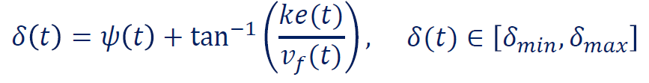
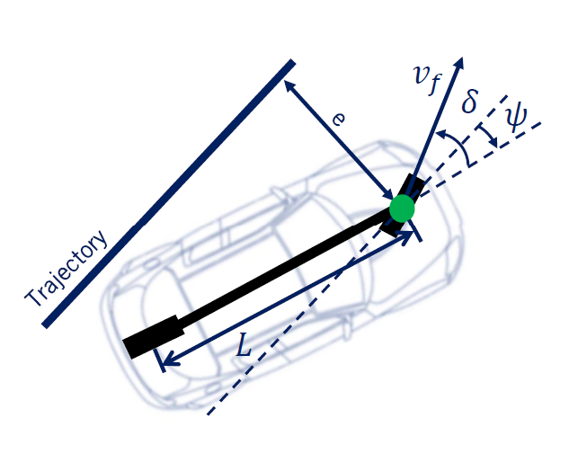
stanley controller
steer to align with heading
at closest point
steer to eliminate cross track error
essentially proportional to error
inversely proportional to speed
limit effect for large errors with inverse tan
gain k determined experimentaly

Slide 27
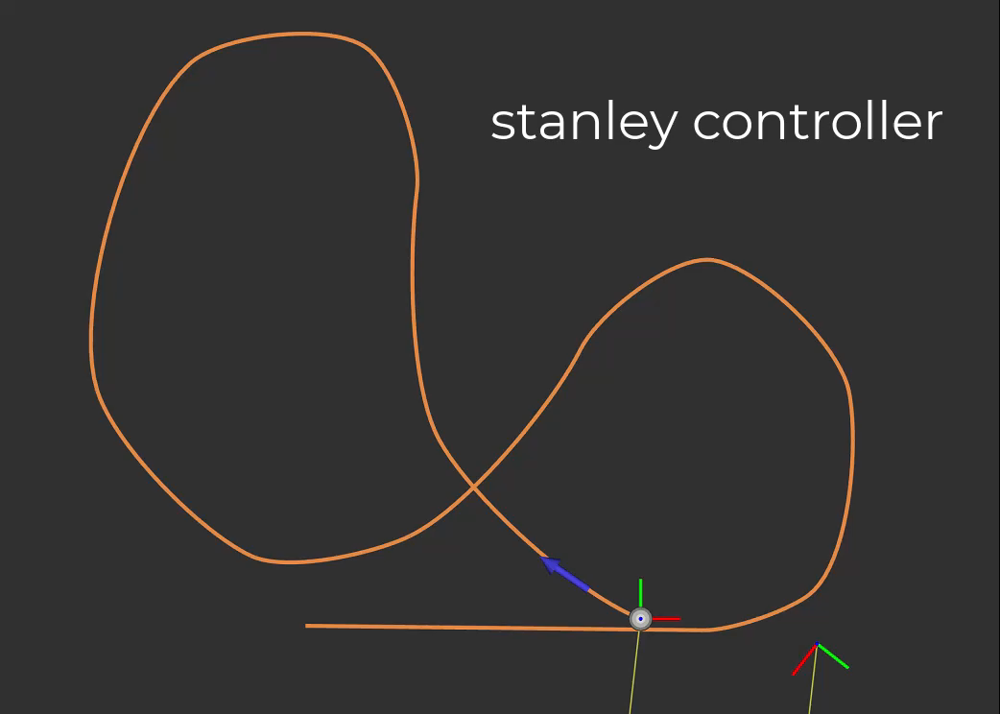
‘magic’ numbers:
K = 1.5
moving coord. is vehicle pose
white dot is closest point on the path to the vehicle

Slide 28
modified stanley controller
given:
vehicle pose, x_{veh}, y_{veh}, θ_{veh}
closest pose, x_{c}, y_{c}, θ_{c}
determine a change in steering angle
to minimize the difference in heading θ_{C} – θ_{veh}
to minimize the cross track distance e
closest pose
θ_{C}
v_{dir_AT_closest}
(x_{C}, y_{C})
0 ≤ K ≤ 1
K is large when abs(e) is small
abs(e) > 10, K = 0
abs(e) < 0.2, K = 1
else K = 1 – 10 abs(e)
e
θ_{veh}
v_{dir_TO_closest}
(x_{veh}, y_{veh})
vehicle pose

Slide 30
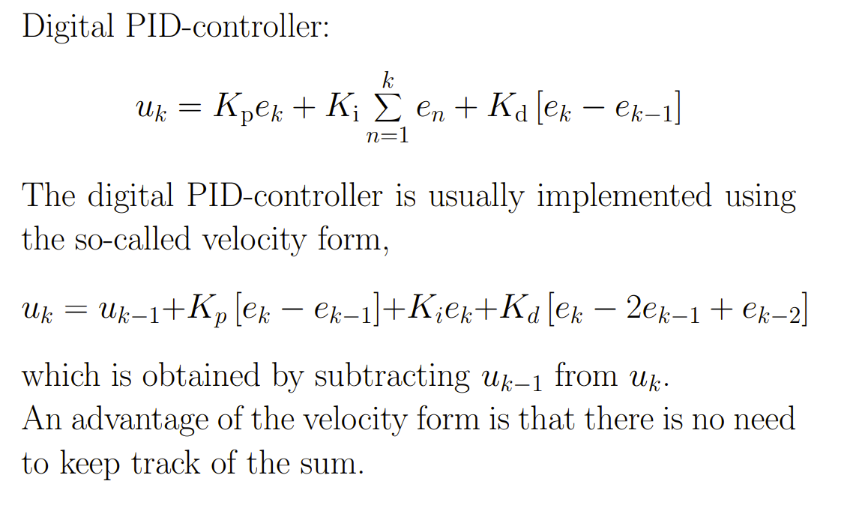
PID Controller
DiscreteTimeSystems.pdf (abo.fi)

